Slide 1
Software Design and Architecture
Lecture-7
Introduction to GoF Patterns

Slide 2
Gang Of Four (GoF) Design Patterns
Best practices in Software Design.
Named after the four authors of book.
Developed by Erich Gamma, Richard Helm, Ralph Johnson, and John Vlissides.
The GoF design patterns are “descriptions of communicating objects and classes that are customized to solve a general design problem in a particular context.”

Slide 3
Design Patterns
Christopher Alexander:
  "Each pattern describes a problem which occurs over and over again in our environment, and then describes the core of the solution to that problem, in such a way that you can use this solution a million times over, without ever doing it the same way twice"

Slide 4
Design Patterns (contd….)
A design pattern names, abstracts, and identifies the key aspects of a common design structure that make it useful for creating a reusable object-oriented design.
The design pattern identifies the participating classes and instances, their roles and collaborations, and the distribution of responsibilities.
Each design pattern focuses on a particular object-oriented design problem or issue.
It describes when it applies, whether it can be applied in view of other design constraints, and the consequences and trade-offs of its use.

Slide 5
Gof Design Patterns Classification
Creational
  Concern the process of object creation.
Structural
  deal with the composition of classes or objects.
Behavioural
  characterize the ways in which classes or objects interact and distribute responsibility.

Slide 6
Scope of Patterns
Scope specifies whether the pattern applies primarily to classes or to objects.
Class patterns deal with relationships between classes and their subclasses.
These relationships are established through inheritance, so they are static—fixed at compile-time.
Object patterns deal with object relationships, which can be changed at run-time and are more dynamic.

Slide 7
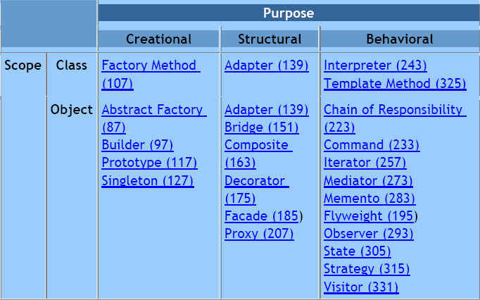

Slide 8
GoF Essential Elements of Patterns
Pattern Name
  Having a concise, meaningful name for a pattern improves communication among developers
Problem
  What is the problem and context where we would use this pattern?
Solution
  A description of the elements that make up the design pattern
  Emphasizes their relationships, responsibilities and collaborations
  Not a concrete design or implementation; rather an abstract description
Consequences
  The pros and cons of using the pattern

Slide 9
GoF Pattern Template
Pattern Name and Classification
  A good , concise name for the pattern and the pattern's type
Intent
  Short statement about what the pattern does
Also Known As
  Other names for the pattern
Motivation
  A scenario that illustrates where the pattern would be useful
Applicability
  Situations where the pattern can be used

Slide 10
GoF Pattern Template contd..
Structure
  A graphical representation of the pattern
Participants
  The classes and objects participating in the pattern
Collaborations
  How do the participants interact to carry out their responsibilities?
Consequences
  What are the pros and cons of using the pattern?

Slide 11
GoF Pattern Template contd..
Implementation
  Hints and techniques for implementing the pattern
Sample Code
  Code fragments for a sample implementation
Known Uses
  Examples of the pattern in real systems
Related Patterns
  Other patterns that are closely related to the pattern

Slide 12
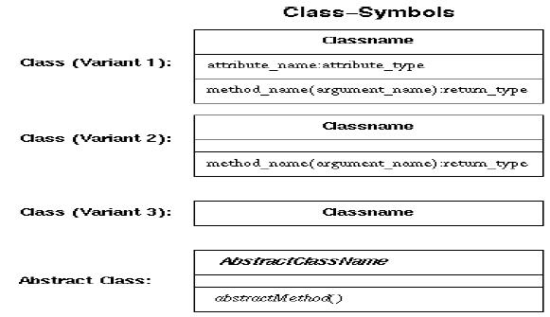
Notations for GoF Patterns

Slide 13
Abstract Classes
An abstract class is one whose main purpose is to define a common interface for its subclasses.
An abstract class will defer some or all of its implementation to operations defined in subclasses; hence an abstract class cannot be instantiated.
The operations that an abstract class declares but doesn't implement are called abstract operations.
Classes that aren't abstract are called concrete classes.

Slide 14
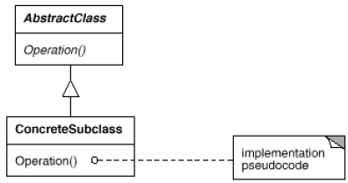
Pseudo code Details
A diagram may include pseudocode for an operation's implementation; if so, the code will appear in a dog-eared box connected by a dashed line to the operation it implements.

Slide 15
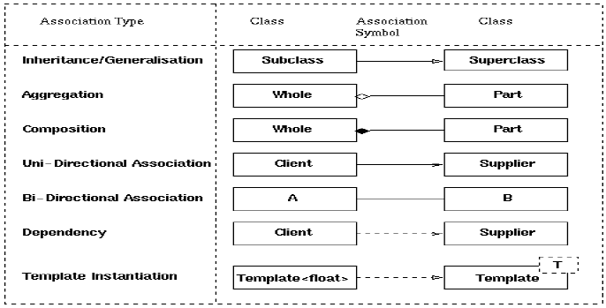
Notations for GoF Patterns contd..

Slide 16
Advantages
Capture expertise and make it accessible to non-experts in a standard form
Facilitate communication among developers by providing a common language
Make it easier to reuse successful designs and avoid alternatives that diminish reusability
Improve design documentation
Improve design understandability

Slide 17
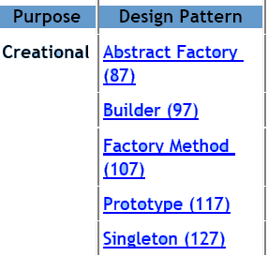
GoF Design Patterns

Slide 18
GoF Creational Patterns
Abstract Factory
  Provide an interface for creating families of related or dependent objects without specifying their concrete classes.
Builder
  Separate the construction of a complex object from its representation so that the same construction process can create different representations.
Factory Method
  Define an interface for creating an object, but let subclasses decide which class to instantiate. Factory Method lets a class defer instantiation to subclasses.
Prototype
  Specify the kinds of objects to create using a prototypical instance, and create new objects by copying this prototype.
Singleton
  Ensure a class only has one instance, and provide a global point of access to it.

Slide 19
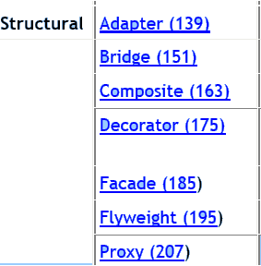
GoF Structural Patterns

Slide 20
GoF Structural Pattern
Adapter
  Convert the interface of a class into another interface clients expect. Adapter lets classes work together that couldn't otherwise because of incompatible interfaces.
Bridge
  Decouple an abstraction from its implementation so that the two can vary independently.
Composite
  Compose objects into tree structures to represent part-whole hierarchies. Composite lets clients treat individual objects and compositions of objects uniformly.

Slide 21
GoF Structural Pattern
Decorator
  Attach additional responsibilities to an object dynamically. Decorators provide a flexible alternative to subclassing for extending functionality.
Facade
  Provide a unified interface to a set of interfaces in a subsystem. Facade defines a higher-level interface that makes the subsystem easier to use.
Flyweight
  Use sharing to support large numbers of fine-grained objects efficiently.
Proxy
  Provide a surrogate or placeholder for another object to control access to it.

Slide 22
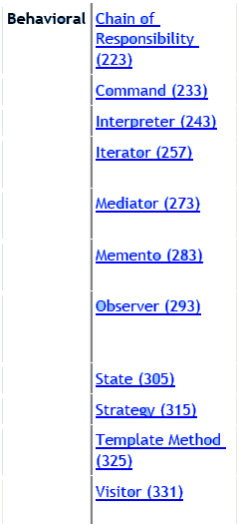
GoF Behavioral Patterns

Slide 23
GoF Behavioral Patterns
Chain of Responsibility
  Avoid coupling the sender of a request to its receiver by giving more than one object a chance to handle the request. Chain the receiving objects and pass the request along the chain until an object handles it.
Command
  Encapsulate a request as an object, thereby letting you parameterize clients with different requests, queue or log requests, and support undoable operations.
Interpreter
  Given a language, define a representation for its grammar along with an interpreter that uses the representation to interpret sentences in the language.
Iterator
  Provide a way to access the elements of an aggregate object sequentially without exposing its underlying representation.

Slide 24
GoF Behavioral Patterns
Mediator
  Define an object that encapsulates how a set of objects interact. Mediator promotes loose coupling by keeping objects from referring to each other explicitly, and it lets you vary their interaction independently.
Memento
  Without violating encapsulation, capture and externalize an object's internal state so that the object can be restored to this state later.
Observer
  Define a one-to-many dependency between objects so that when one object changes state, all its dependents are notified and updated automatically.
State
  Allow an object to alter its behavior when its internal state changes. The object will appear to change its class.

Slide 25
GoF Behavioral Patterns
Strategy
  Define a family of algorithms, encapsulate each one, and make them interchangeable. Strategy lets the algorithm vary independently from clients that use it.
Template Method
  Define the skeleton of an algorithm in an operation, deferring some steps to subclasses. Template Method lets subclasses redefine certain steps of an algorithm without changing the algorithm's structure.
Visitor
  Represent an operation to be performed on the elements of an object structure. Visitor lets you define a new operation without changing the classes of the elements on which it operates.

Slide 26
Suggested Reading
Design Patterns: Elements of Reusable Object-Oriented Software.
  Introduction Chapter
  Pages 9-32

